Slide 1
Scrutinizing Soybean Futures
By- John, Kiel, Shubha, Shantanu, Himanshu
(a.k.a. - perceptron)
Powered By- Dorin, Michael

Slide 2
Data Science Process
The Team Data Science Process (TDSP) lifecycle is composed of five major stages that are executed iteratively. These include:
1. Business Understanding
2. Data Acquisition and Understanding
3. Modeling
4. Deployment
5. Customer Acceptance
Source: Microsoft
Notes:
https://docs.microsoft.com/en-us/azure/machine-learning/team-data-science-process/
The Team Data Science Process (TDSP) provides a recommended lifecycle that you can use to structure the development of your data science projects. The lifecycle outlines the steps, from start to finish, that projects usually follow when they are executed. If you are using another data science lifecycle, such as CRISP-DM, KDD or your organization's own custom process, you can still use the task-based TDSP in the context of those development lifecycles. +
This lifecycle has been designed for data science projects that are intended to ship as part of intelligent applications. These applications deploy machine learning or artificial intelligence models for predictive analytics. Exploratory data science projects and ad hoc or on-off analytics projects can also benefit from using this process, but in such cases some steps described may not be needed.

Slide 3


Domain Knowledge Resources

Slide 4
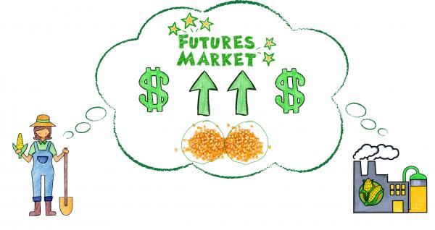
Business Understanding - Domain knowledge
Source: harvestpublicmedia
Producers and Consumers: All soybeans futures contracts require the traders to put up the initial margin and a maintenance margin and comes with contract expiration months.
Uses: It is widely used as livestock feed(China hogs), a substitute for meat, as well as a source of oil.
Supply and Demand:
Brazil , U.S., Argentina (90% Soybean production)
80% of soybean farming in US comes from the Midwest
Biggest Importer: China (Tariffs)
Competitive Crops: Midwest Ag- 75% of land is used by corn and/or soybeans
Notes:
Soybean Futures - From <https://tradingsim.com/blog/6-things-you-must-know-about-soybean-futures-trading/>
https://www.harvestpublicmedia.org/post/watch-how-futures-market-helps-keep-your-grocery-bill-down
They're typically charged as a percentage of the transaction price that a buyer pays a foreign seller. In the United States, tariffs — also called duties or levies — are collected by Customs and Border Protection agents at 328 ports of entry across the country.
Export:
Brazil 50%, U.S. 40%, Argentina8%..

Slide 5
Data Exploration - Questionnaire
Price Differences by Contract:
High, Low and Close prices follows almost same trend for each contract (July>May>March).
Seasonality:
Most of the time: Prices are going high during blooming and Harvesting Period (July to Oct)
Effect of Delayed Seeding: May, June and July are high volume in seeding months and Contract rates are falling for those months with respect to prior years.
Prices of Soybean futures have been dropping after 2016 Contracts (before Approx. 12.00), Nowadays, It stays below 11.20
Corn Prices /Canola Price: There very little correlation with soybean price.
Yuan/Trade Weighted U.S. Dollar Index - Inversely Correlated
Notes:
Answer Novice questions:
● What trends do you see in U.S. soybean exports?
After 1980 till 1985, there has been an average increase of 86% in soybean export from the US while the average agricultural exports from the US increased by only 39%. After 1991, both the soybean export and the agricultural exports from the US have shown a similar trend with a maximum deviation of 6.8% and 8.5%, respectively. In general, the average agricultural exports show a positive correlation with the soybean export over a period of 29 years.
● What seasonality do you see in the data?
● Do you see any relationships between commodity exports (substitutable products: corn/soybeans)?
Till 1987, the average corn export was higher than the average soybean export, although the trend was similar. From 1987 till 2012 the average soybean export superseded the average corn export by 2.8% but after 2012, the average corn export has been steadily increasing more than the average soybean export.
● Are we trade neutral for agricultural products in a given month/year (consider columns past BE)?
● Does competitor exports of soybeans (column AK) impact US exports of soybeans? After 2012 it goes together
Answer Undergrad Questions:¶
What is the price difference by contract date?
Is there seasonality in the target variable for a given contract date?
Is canola price predictive of soybean price?
Is there an effect of the delayed 2019 seeding on soybean prices (see time lag in data sets on Oil Crops Outlook tab: oil crops chart gallery figure 1)?
Answer Grad questions:¶
5. Is there a lag between tweets related to agriculture and/or trade and the markets?
6. What are the most impact indicators to watch from the next top three soybean producing countries (Brazil, Argentina and China)?
7. What other data sources could you use as macroeconomic indicators, and what is their relative importance?

Slide 6
Data Preparation: Soybean Futures Prices
General
Causal Factors
Trade-war and Tariffs (Trump tweets)
Seasonality – Planting, Blooming, Harvest (by Year)
Supply and Demand (Exports)
Market
Causal Factors
Last Days Price (EOD Price)
Volume Weighted Average Price (VWAP)
Percentage Change Per Day (Change)
Weather – Forest fire Brazil
Competitors – Brazil, Argentina
Widespread Disease (African swine fever, Asian rust)
News – Relevance, Sentiments and Magnitude
Trade Weighted U.S. Dollar Index
USD-Yuan Exchange Rate
Competitive Crops Prices – Corn, Wheat

Slide 7
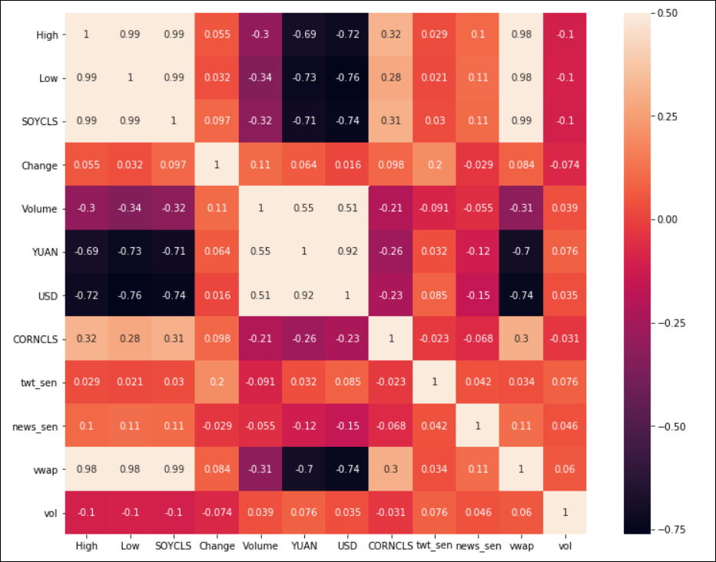
Correlation with EOD Price
Yuan/USD is inversely proportional
News/tweets sentiment are related
1 is a perfect positive correlation, 0 is no correlation, -1 is a perfect negative correlation
Recursive Feature Elimination: Gives the ranking of all the variables, 1 being most important.
Notes:
Correlation Check: 1 is a perfect positive correlation, 0 is no correlation (the values don't seem linked at all), -1 is a perfect negative correlation
We will only select features which has correlation of above 0.5 (taking absolute value) with the output variable. As a general guideline, we should keep those variables which show a decent or high correlation with the target variable.
Recursive Feature Elimination : The RFE method takes the model to be used and the number of required features as input. It then gives the ranking of all the variables, 1 being most important.

Slide 8
Modelling: Sequence Forecasting - Training Process (Step X)
Recursive Feature Elimination: Gives the ranking of all the features, 1 being most important.
MODEL TRAINING
TRAINING
Training Set
(Beginning of the Time Series – 70% rows)
Machine Learning
LSTM, XGBoost, LightGBM…
Feature Engineering
Prev-Day EOD Price, Change %, VWAP (Incorporates 7 features)
Validation Set
(Middle of the Time Series – 10% rows)
Raw Daily Time Series Data/Target
Number of rows
HYPERPARAMETER TUNING
Ensemble Model
(Trained on Whole Data)
Test Set
(End of the Time Series – 20% rows)
PERFORMANCE EVALUATION
STEP X PREDICTION
Last Sequence from Dataset
Predict
Predicted Step X Sequence
[949.69, 943.44, 943.44…]
[952.69]
Notes:
Why not Supply and Demand? Not in high correlation, vwap including that volatility
Find the average price the stock traded at over the first five-minute period of the day. To do this, add the high, low, and close, then divide by three. Multiply this by the volume for that period. Record the result in a spreadsheet, under column PV.
Divide PV by the volume for that period. This will give the VWAP value.
Data was taken from Barchart.
Bagging to decrease the model’s variance; RandomForest (Train Data Bootstraping and Aggregation)
Boosting to decreasing the model’s bias, and; XGBoost (New model is trained from the errors of previous learners)
Stacking to increasing the predictive force of the Regressor. (new model is trained from the combined predictions of two (or more) previous model.)

Slide 9
Model Complexity Model for Each Day (Step X) and Each Contract
Data | Day 1 Prediction | Day 2 Prediction | Day 3 Prediction | Day 4 Prediction | Day 5 Prediction
Input: | Previous days EOD, VWAP, CHANGE | Previous days EOD, VWAP, CHANGE | Previous days EOD, VWAP, CHANGE | Previous days EOD, VWAP, CHANGE | Previous days EOD, VWAP, CHANGE
Output: | 1 Step EOD | 2 Step EOD | 3 Step EOD | 4 Step EOD | 5 Step EOD

Slide 10
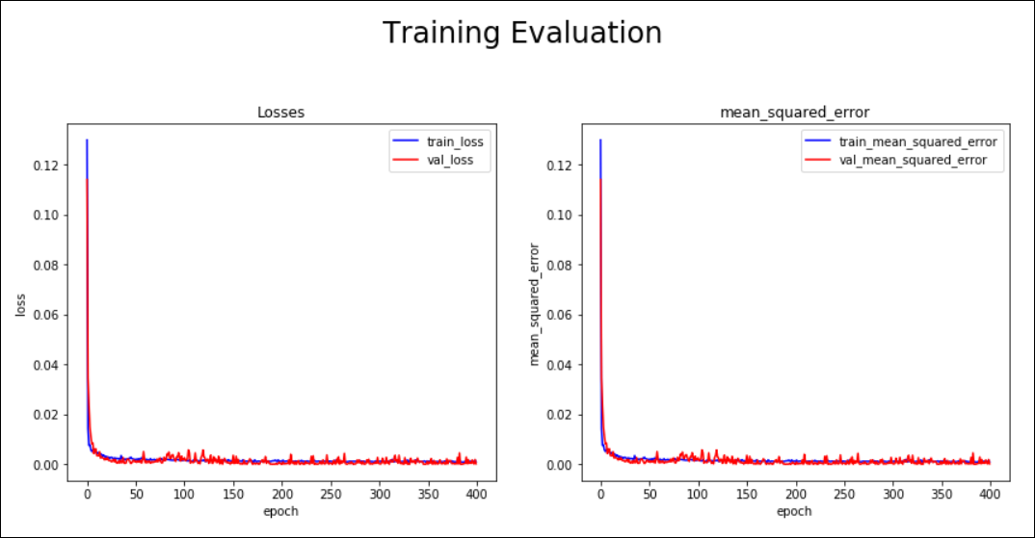
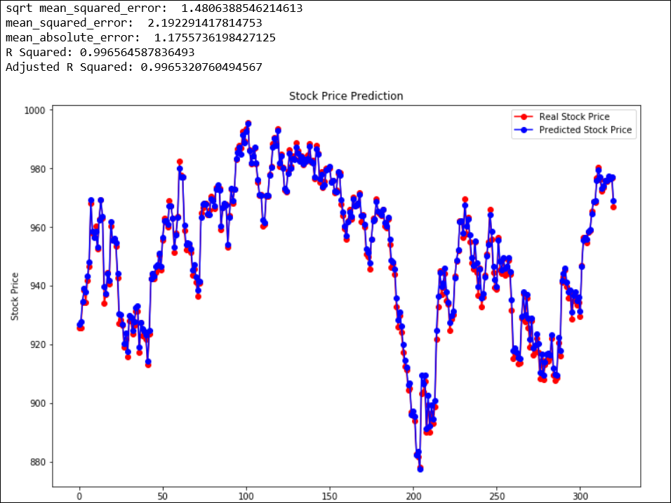
Evaluation and Results
ZSN20- Prediction on Next 300 days, 99.65% on Test Set with optimal Training, Validation , Test loss
Best fit- Test Loss Low + Validation Loss Low
100+ Different experiments and model prediction verification on Oct25 week prediction before final submission for Nov 4th week pred: total Loss-
$ 0.52967 total error (Absolute sum of 5 days and 3 contract)
Notes:
R-squared = Explained variation / Total variation
R-squared is always between 0 and 100%:
0% indicates that the model explains none of the variability of the response data around its mean.
100% indicates that the model explains all the variability of the response data around its mean.
In general, the higher the R-squared, the better the model fits your data.

Slide 11
Conclusion
Advantage:
LSTM - Essentially a nonlinear timeseries model, where the nonlinearity is learned from the data.
Deployment was extremely good. Average error $ 0.03 each day, each contract
Disadvantage:
Multi-step prediction gets worse with each step (i.e. day)
Requires models for each day and each contract
Retraining and maintenance is necessary
Data is time-variant, Hard to perform cross-validation (K-Fold)
Future Work:
Fine Tuning more complex models
5 Day Prediction Website (Compare Predicted vs Real)
Re-Evaluating model performance (Including new causal factors if new arrives)
Experiment new methods –LSTM (seq to seq prediction), Reinforcement Learning

Slide 12
Feature Importance
Weight. The number of times a feature is used to split the data across all trees.
Cover. The number of times a feature is used to split the data across all trees weighted by the number of training data points that go through those splits.
Gain. The average training loss reduction gained when using a feature for splitting.
Consistency. Whenever we change a model such that it relies more on a feature, then the attributed importance for that feature should not decrease.
Accuracy. The sum of all the feature importance should sum up to the total importance of the model. (For example if importance is measured by the R² value then the attribution to each feature should sum to the R² of the full model)
Notes:
https://towardsdatascience.com/interpretable-machine-learning-with-xgboost-9ec80d148d27
If consistency fails to hold, then we can’t compare the attributed feature importance between any two models, because then having a higher assigned attribution doesn’t mean the model actually relies more on that feature.
If accuracy fails to hold then we don’t know how the attributions of each feature combine to represent the output of the whole model. We can’t just normalize the attributions after the method is done since this might break the consistency of the method.

Slide 13
Shapley value: It is the average of the marginal contributions across all permutations.
SHAP (SHapley Additive exPlanations) –
The first one is global interpretability — the collective SHAP values can show how much each predictor contributes, either positively or negatively, to the target variable. This is like the variable importance plot but it is able to show the positive or negative relationship for each variable with the target (see the SHAP value plot below).
The second benefit is local interpretability — each observation gets its own set of SHAP values (see the individual SHAP value plot below). This greatly increases its transparency. We can explain why a case receives its prediction and the contributions of the predictors. Traditional variable importance algorithms only show the results across the entire population but not on each individual case. The local interpretability enables us to pinpoint and contrast the impacts of the factors.
Third, the SHAP values can be calculated for any tree-based model, while other methods use linear regression or logistic regression models as the surrogate models.
The top variables contribute more to the model than the bottom ones and thus have high predictive power.
Notes:
https://towardsdatascience.com/explain-your-model-with-the-shap-values-bc36aac4de3d

Slide 14
This plot is made of all the dots in the train data. It demonstrates the following information:
Feature importance: Variables are ranked in descending order.
Impact: The horizontal location shows whether the effect of that value is associated with a higher or lower prediction.
Original value: Color shows whether that variable is high (in red) or low (in blue) for that observation.
Correlation: A high level of the “alcohol” content has a high and positive impact on the quality rating. The “high” comes from the red color, and the “positive” impact is shown on the X-axis. Similarly, we will say the “volatile acidity” is negatively correlated with the target variable.

